Slide 1
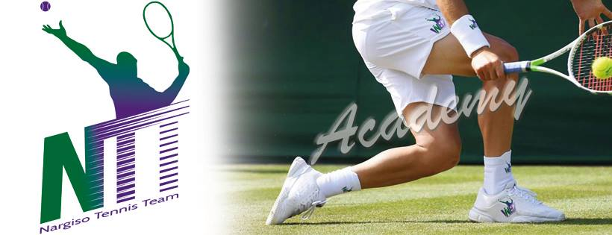
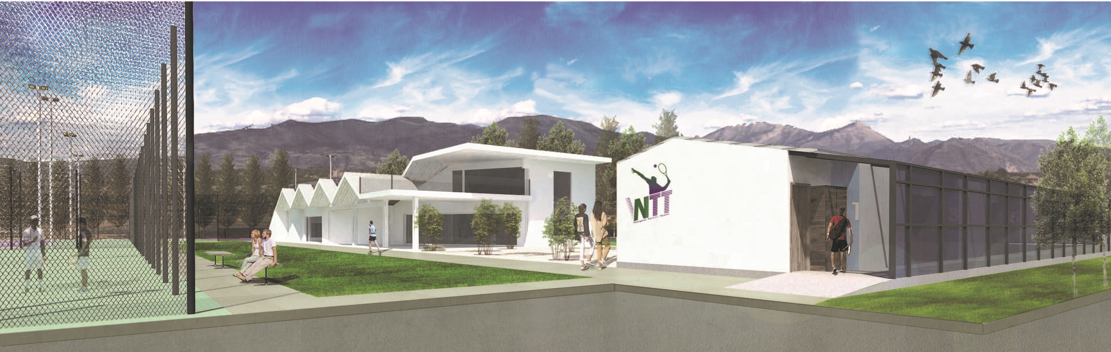
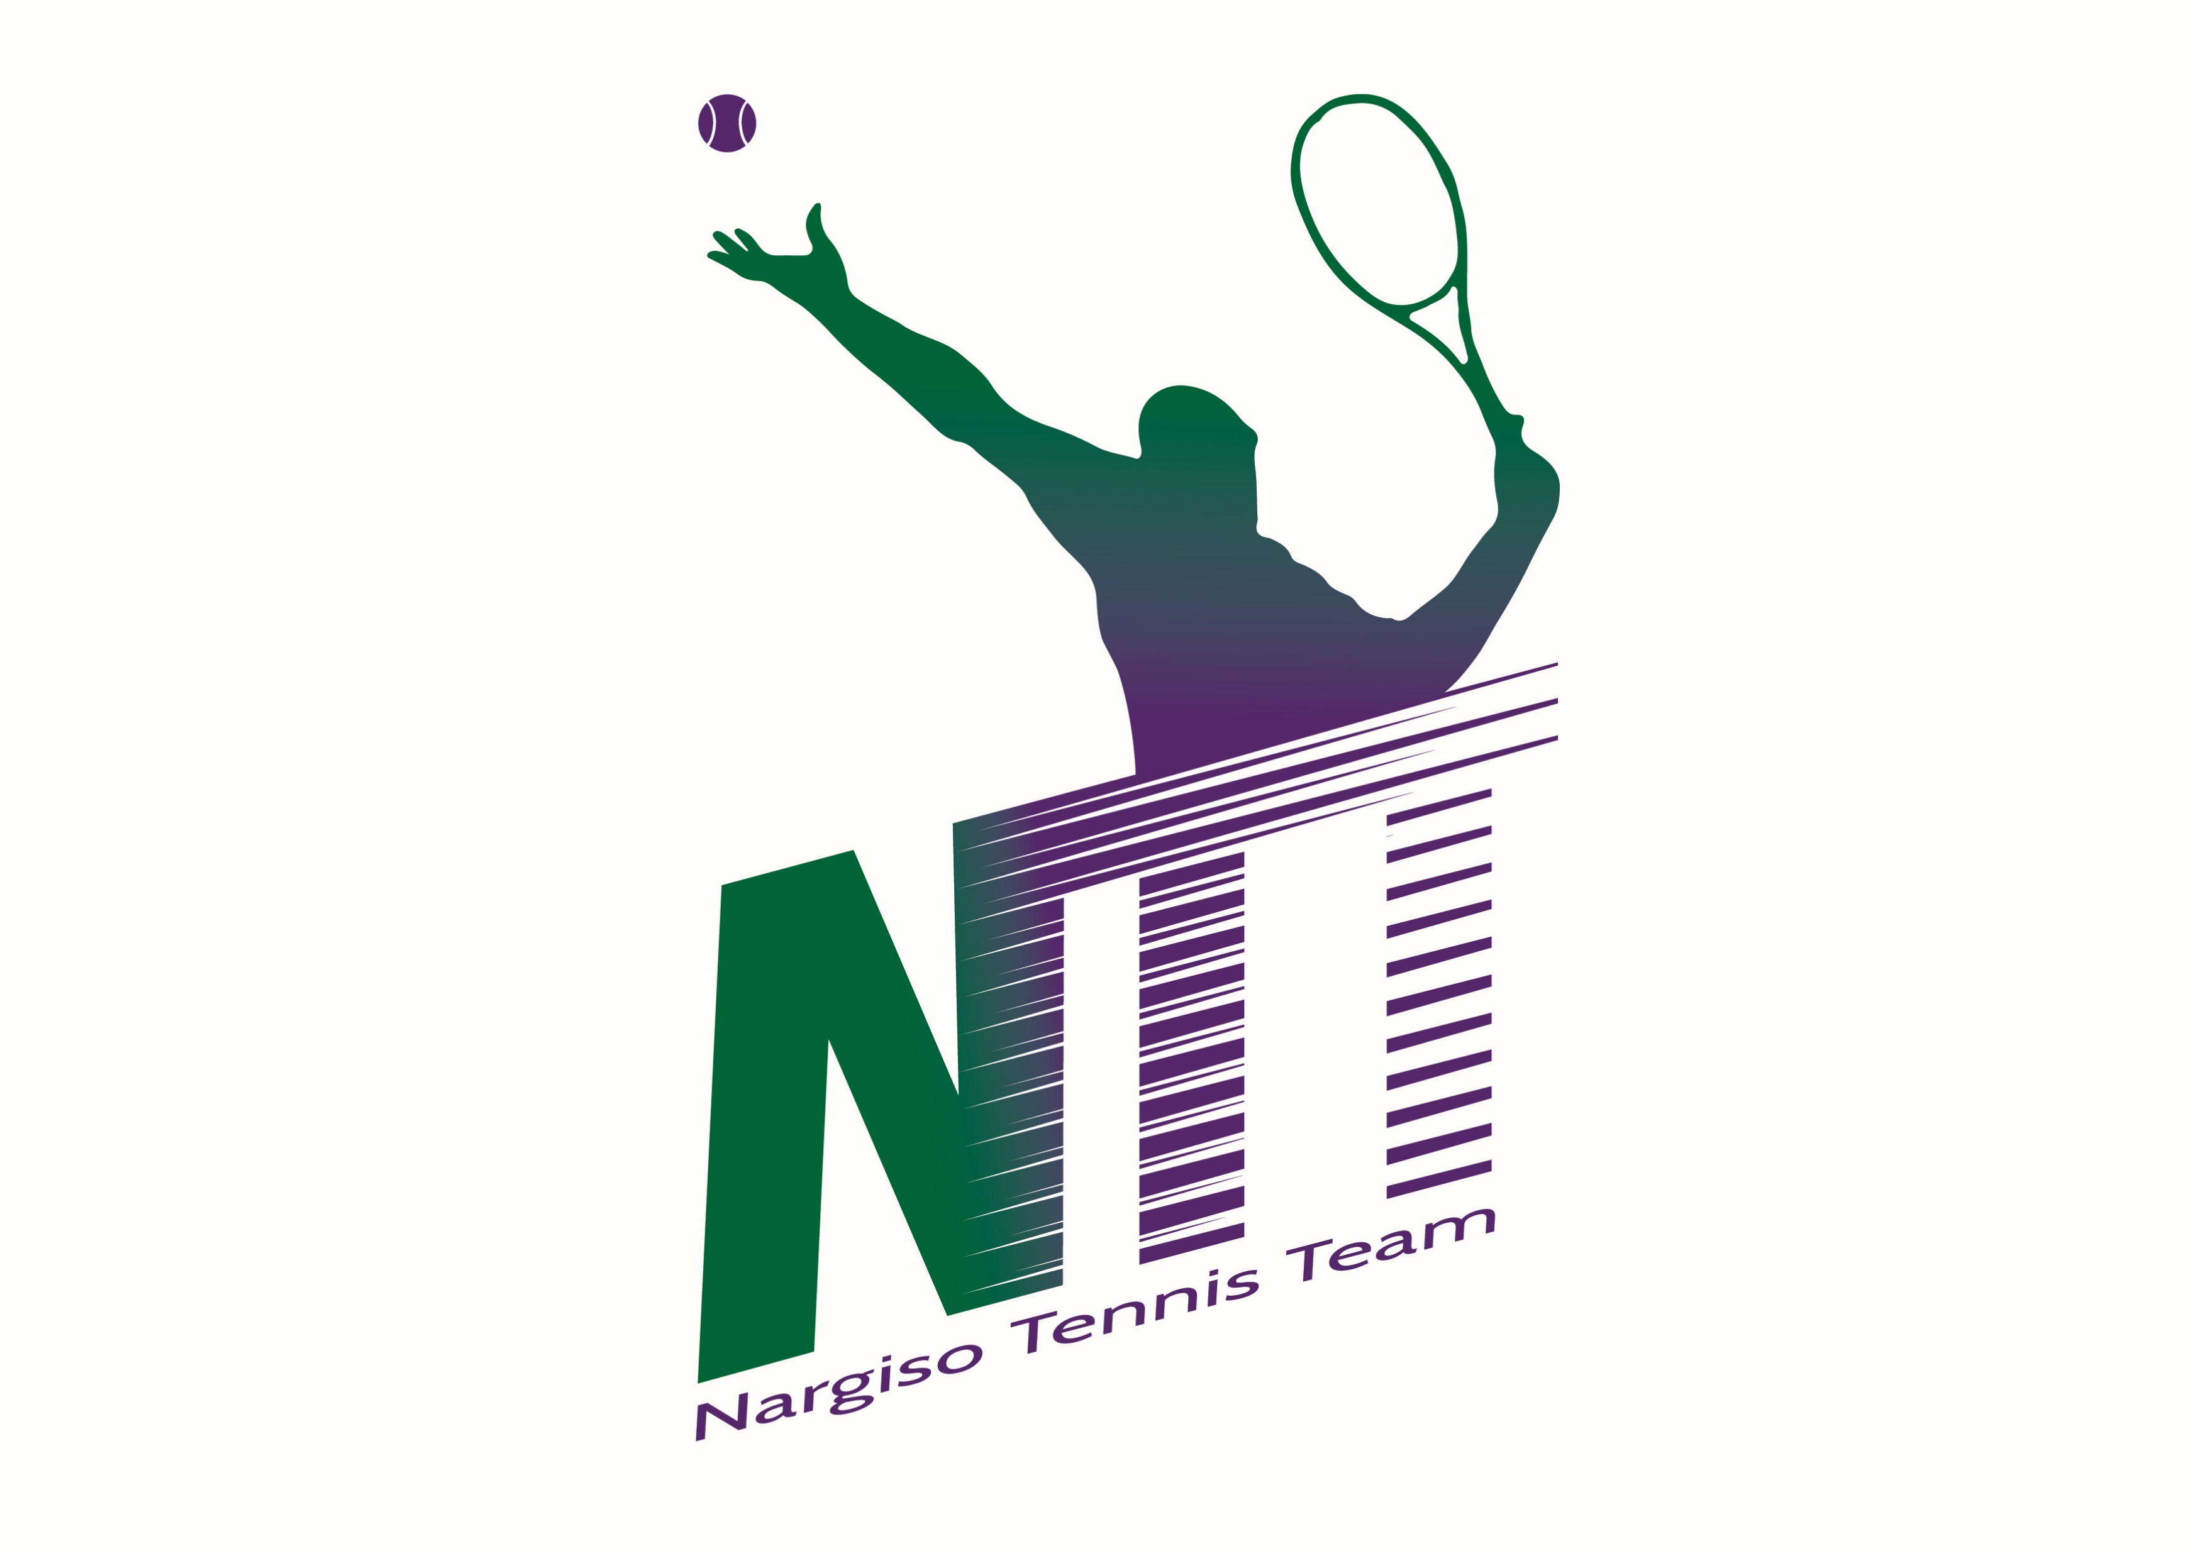


Slide 2

NARGISO TENNIS TEAM
SPONSORSHIP AGREEMENT

Slide 3

THE PROJECT by DIEGO NARGISO
Diego Nargiso is the founder of NTT.
As a Coach from 2012/to 2018 :
-Raises up Top 50 players in the early stages of their career like Volandri,
Pennetta and Krajinovic
-He is nominated best Italian Coach 2014/2015
-He works on Djokovic team in 2015 raising up young talents like Krajinovic
-Since 2012 he directs ITA Tennis Academy working with over 50 players ( juniors and pros) collecting many Junior and Pro ITF Titles.
As an ATP Player:
-Wimbledon winner in Junior 1987
-Member of Olympic Team in Seoul 1988, Barcelona 1992 and
Atlanta 1996
-In Davis Cup 32 matches, Finalist in 1998 and semifinalist 1996/1997
-In ATP major Tour 5 titles in Doubles and 18 finals in Singles and Doubles
-Plays Main Draw in 39 Grand Slam, 3rd round in Wimbledon and Us Open
La NTT Academy, il cui direttore tecnico-sportivo designato alla gestione dell’accademia sarà Diego Nargiso (in allegato C.V.), che dopo essere stato giocatore nella nostra nazionale di Coppa Davis negli anni ‘90, ha operato nel management sportivo ideando ed organizzando progetti nel sociale come “Saranno Sportivi” uniti ad eventi di grande rilevanza internazionale come l’ATP Challenger di Napoli 1995/1999 o ancora manifestazioni come il “Saranno campioni” che su scala nazionale ha coinvolto piu di 4.000 giovani nel praticare il loro sport preferito. Nargiso ha anche allevato e cresciuto diversi giocatori tra cui Flavia Pennetta top 10 WTA, Filippo Volandri Top 20 ATP ed ha collaborato con Novak Djokovic nel 2015 alla crescita del suo pupillo Krajinovic con il quale ha raggiunto la top 100 ATP. Nargiso e’ stato già nominato miglior coach italiano nel 2014 e nel 2015
New Lario Park, via Olimpica 1, Lipomo, (Como):
New Lario Park, via Olimpica 1, Lipomo, (Como):

Slide 4
THE NARGISO TENNIS CENTER:
Situated in Lombardia, in the city of Lomazzo, only a few Km away from Malpensa airport and city of Milan.
The Center will have n. 6 courts, 2 Clays and 4 Hard Courts. All Courts will be covered in winter.
The Club House will be able to host the athletes, it will have a reception, a bar-restaurant, locker room and a Gym. There will be a pool for summer time.
Unique in Italy, the Nargiso Tennis Center will be able to host 30 players in his 10 apartments-suites.

Slide 5
ACADEMY SERVICES
- TENNIS TRAINING
- PHYSICAL TRAINING
- MENTAL COACHING
- HEALTH AND NUTRITION
- SCHOOL ON SITE
- INJURY REHABILITATION
- HOSPITALITY

Slide 6
Events
PRO TOURNAMENTS ATP/WTA/ITF
ITF SENIOR/JUNIOR TOUR

Slide 7
  SPONSOR POSITIONING
    Fence Banner in 6 courts;
    Positioning your Logo on NTT internet page;
    Positioning your Logo on social NTT Facebook page;
    Dedicated zones in exclusive way to your material;
    Exclusive Pro shop in NTT Club House for racquets and balls;
    Events(clinic, incentive, team building) dedicated to your Company
    Positioning your logo on NTT staff and teams.

Slide 8
THANKS
FOR YOUR ATTENTION

